Slide 1
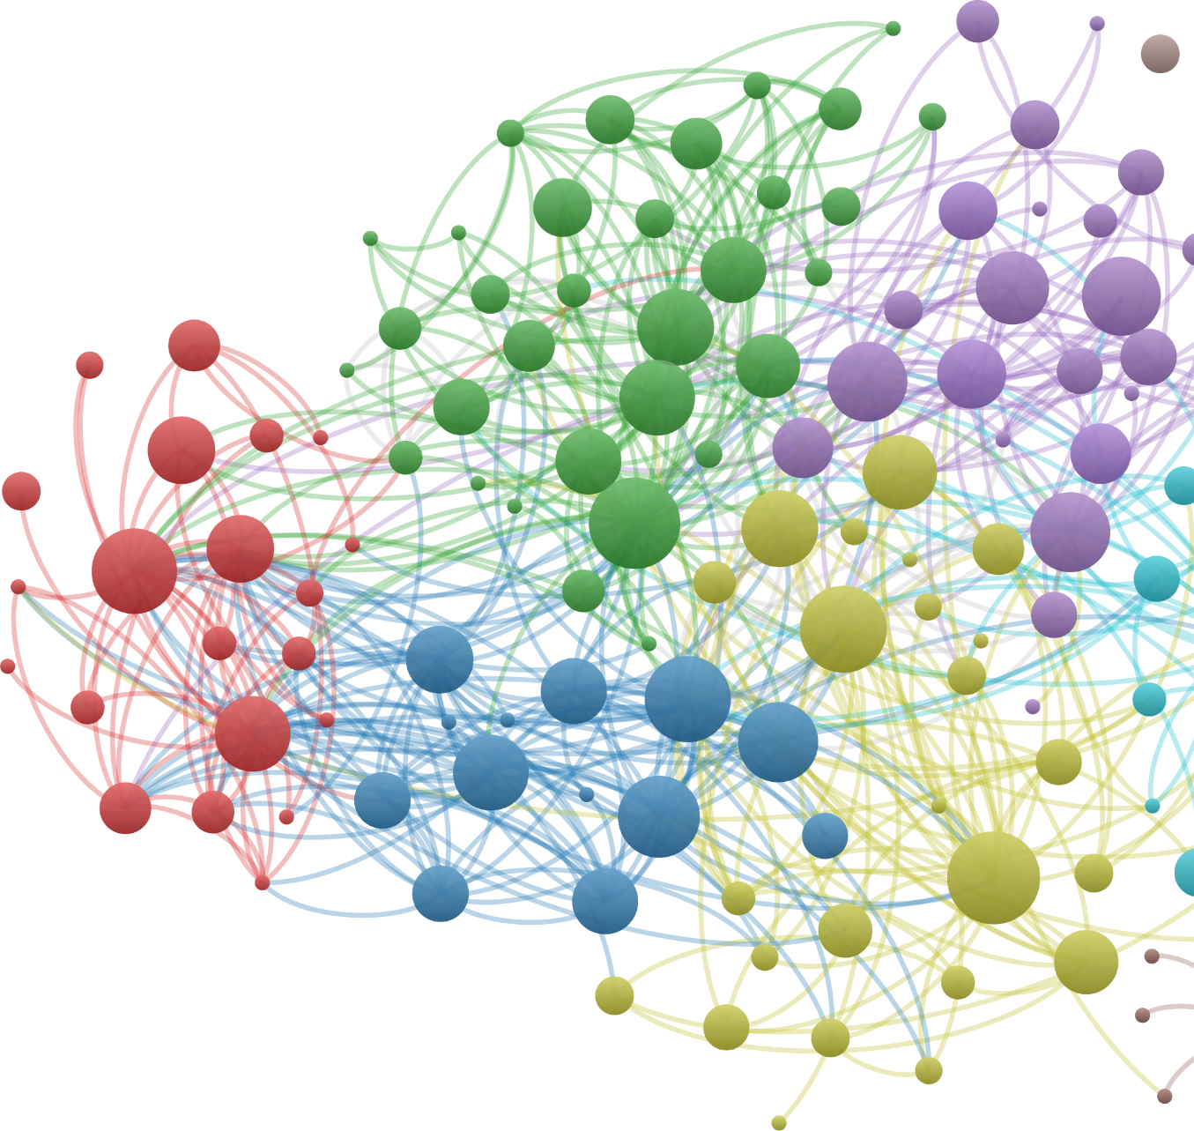

Mapping the Role of Practitioners in LIS Scholarship
Amy Trost
University of Maryland Libraries
The Universities at Shady Grove
March 7, 2019
Notes:
Honored to be here. I’m fairly new to UMD, this work represents me trying to open up new avenues for both scholarship and practice at UMD libraries. All preliminary, just starting, interested in collaborating & working with others to explore/expand on the kinds of bibliometric services & resources we can do/offer

Slide 2
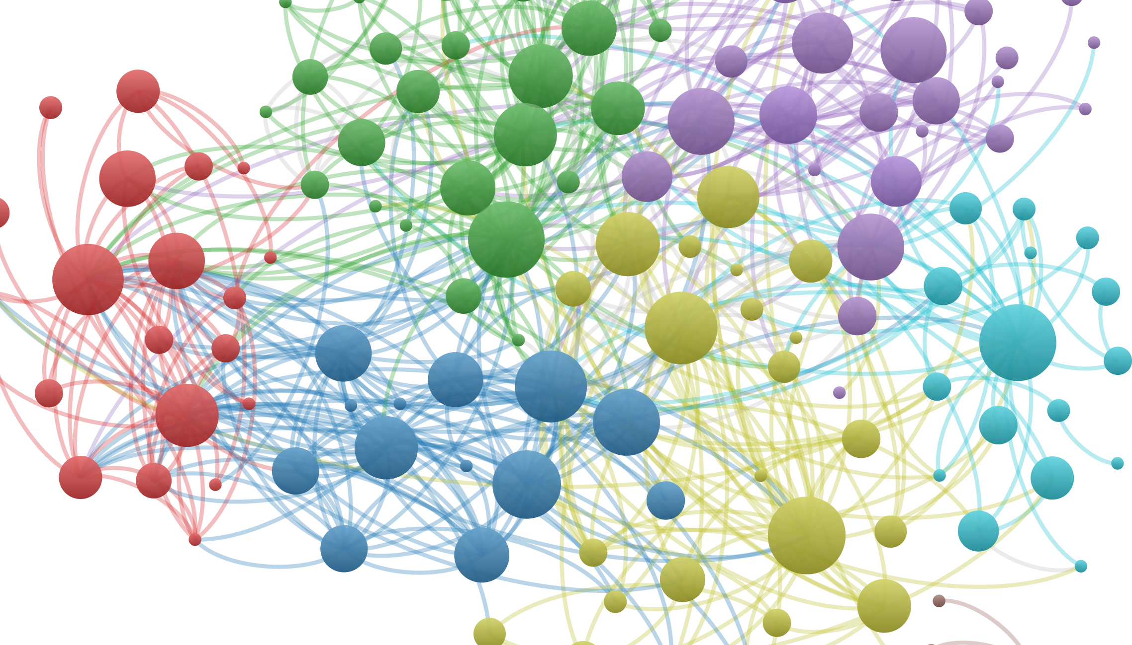
Who?
Librarian-scholars in the UMD system
Bibliographic data on academic librarianship from three sources: Web of Science, Google Scholar, and EBSCO’s Library and Information Science Source
What?
Proof of concept to promote bibliometric services, an example of a research group’s contribution to a larger body of scholarship
Why?
Notes:
“librarian scholars” is silly. We don’t do that much scholarship, but it actually made it a good challenge. Wanted to search a lot of databases, get a sense of coverage from different sources, also get experience working with different kinds of records (before this I was at NIST and only had worked with Web of Science data). This research question starts to push beyond some of the bibliometric analysis I had done in the past.

Slide 3
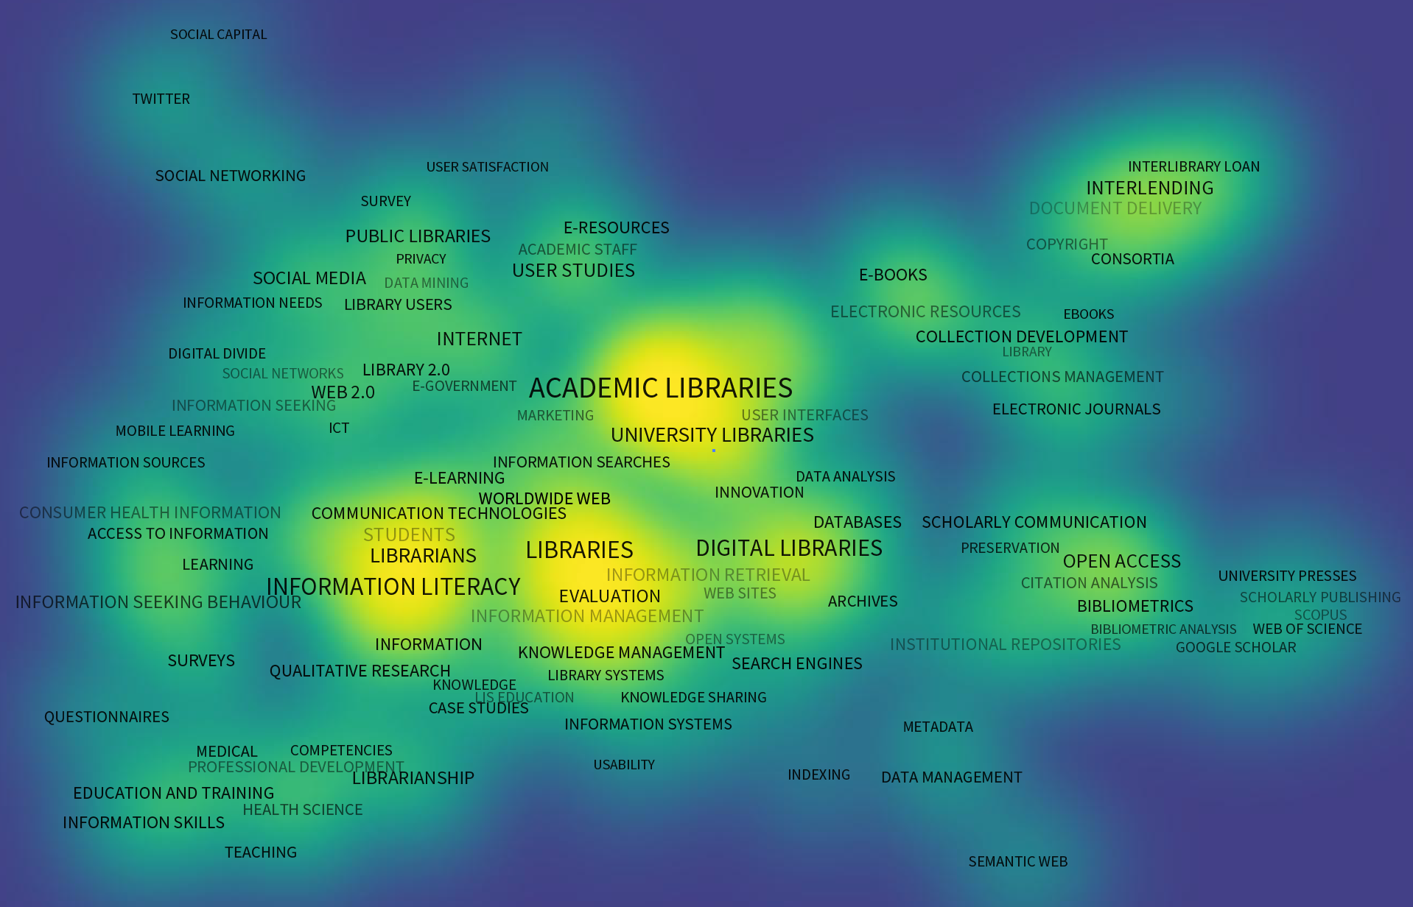
Source # 1: Web of Science
Tools Used: R’s bibliometrix package, VOSviewer (Sci2 would work also)
Challenges: Selecting which journals to include
The 150 most frequently chosen author-defined keywords in a set of 5,000 Web of Science publications, clustered based on their co-occurrence in the same papers.
Notes:
This is the easiest format of records to work with…

Slide 4

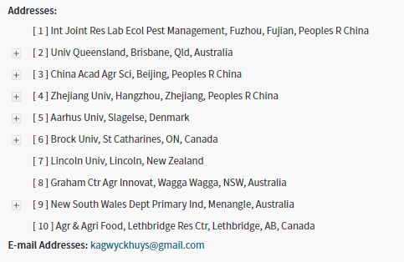
A word on author disambiguation (and other data cleaning troubles)
[Wyckhuys, K. A. G.; Pozsgai, G.; Lovei, G. L.; Vasseur, L.; Wratten, S. D.; Gurr, G. M.; Reynolds, O. L.; Goettel, O.] Int Joint Res Lab Ecol Pest Management, Fuzhou, Fujian, Peoples R China; [Wyckhuys, K. A. G.] Univ Queensland, Brisbane, Qld, Australia; [Wyckhuys, K. A. G.] China Acad Agr Sci, Beijing, Peoples R China; [Wyckhuys, K. A. G.] Zhejiang Univ, Hangzhou, Zhejiang, Peoples R China; [Lovei, G. L.] Aarhus Univ, Slagelse, Denmark; [Vasseur, L.] Brock Univ, St Catharines, ON, Canada; [Wratten, S. D.] Lincoln Univ, Lincoln, New Zealand; [Gurr, G. M.; Reynolds, O. L.] Graham Ctr Agr Innovat, Wagga Wagga, NSW, Australia; [Reynolds, O. L.] New South Wales Dept Primary Ind, Menangle, Australia; [Goettel, O.] Agr & Agri Food, Lethbridge Res Ctr, Lethbridge, AB, Canada
Notes:
“librarian scholars” is silly. We don’t do that much scholarship, but it actually made it a good challenge. Wanted to search a lot of databases, get a sense of coverage from different sources, also get experience working with different kinds of records (before this I was at NIST and only had worked with Web of Science data). This research question starts to push beyond some of the bibliometric analysis I had done in the past.

Slide 5
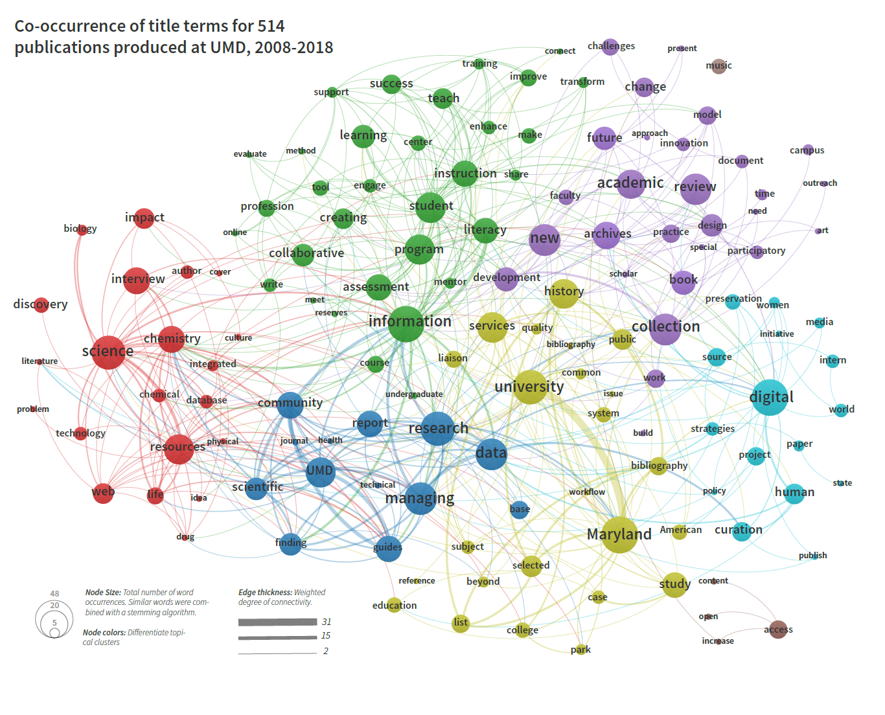
Source # 2: Google Scholar
Tools Used: R’s text mining (tm) & scholar packages, Gephi, VOSviewer
Challenges: lack of metadata, difficult to scrape, different scope

Slide 7
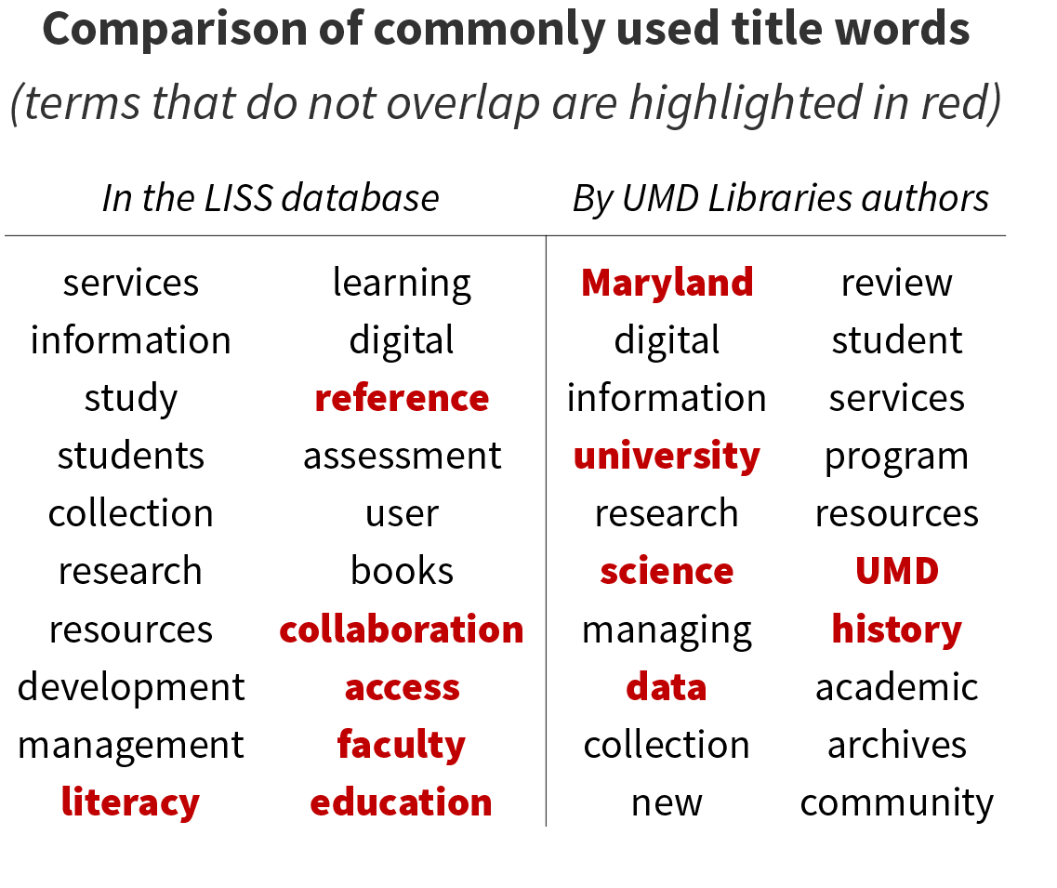
Source # 3: LISS
Tools Used: R’s text mining (tm) package, Excel macros
Challenges: Selecting which journals to include
The most common words appearing the titles of articles relating to academic librarianship, in LISS and from UMD (found in Google Scholar). Terms that do not closely overlap are highlighted in red.

Slide 8
Questions?
Please contact me!
atrost1@umd.edu
Twitter: @AmyTrost
GitHub: amytrost

